Slide 1
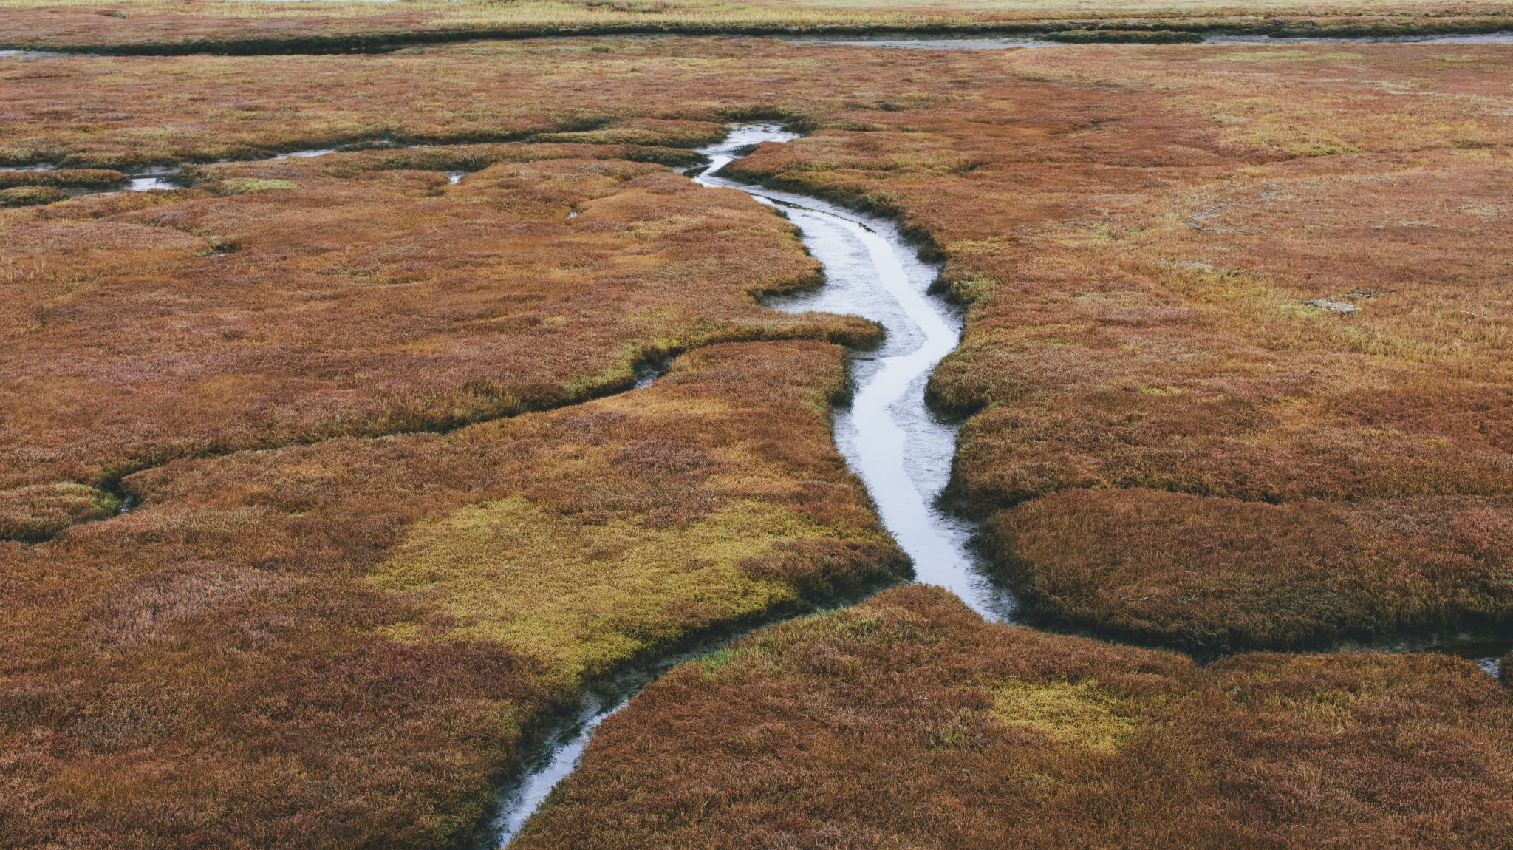
Belle Isle Creek/ Winthrop Bay Watershed Area
Grace Wu

Slide 2
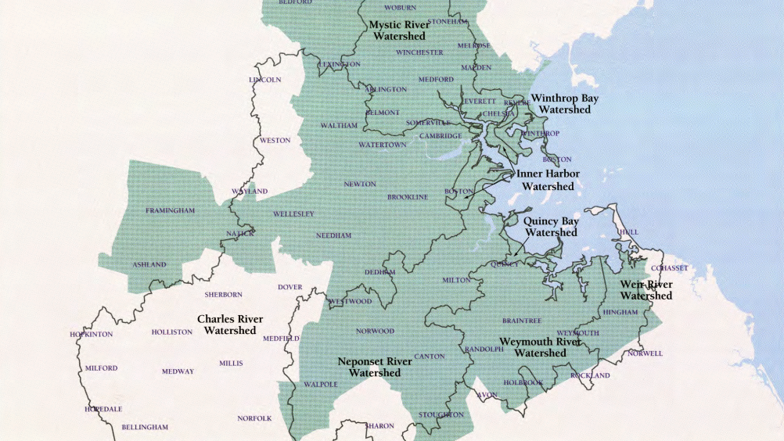
Source: MWRA Online.
https://www.mwra.com/harbor/enquad/pdf/1995-12.pdf.

Slide 3
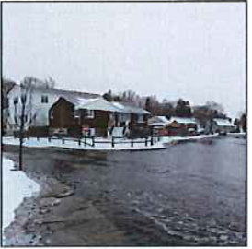
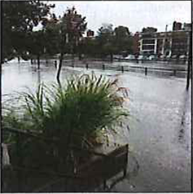
Belle Isle Creek/ Winthrop Bay Watershed Assessment Area Boundary. (2017). Source: Mass.gov Ecosystem Delineation and Assessment.

Slide 4
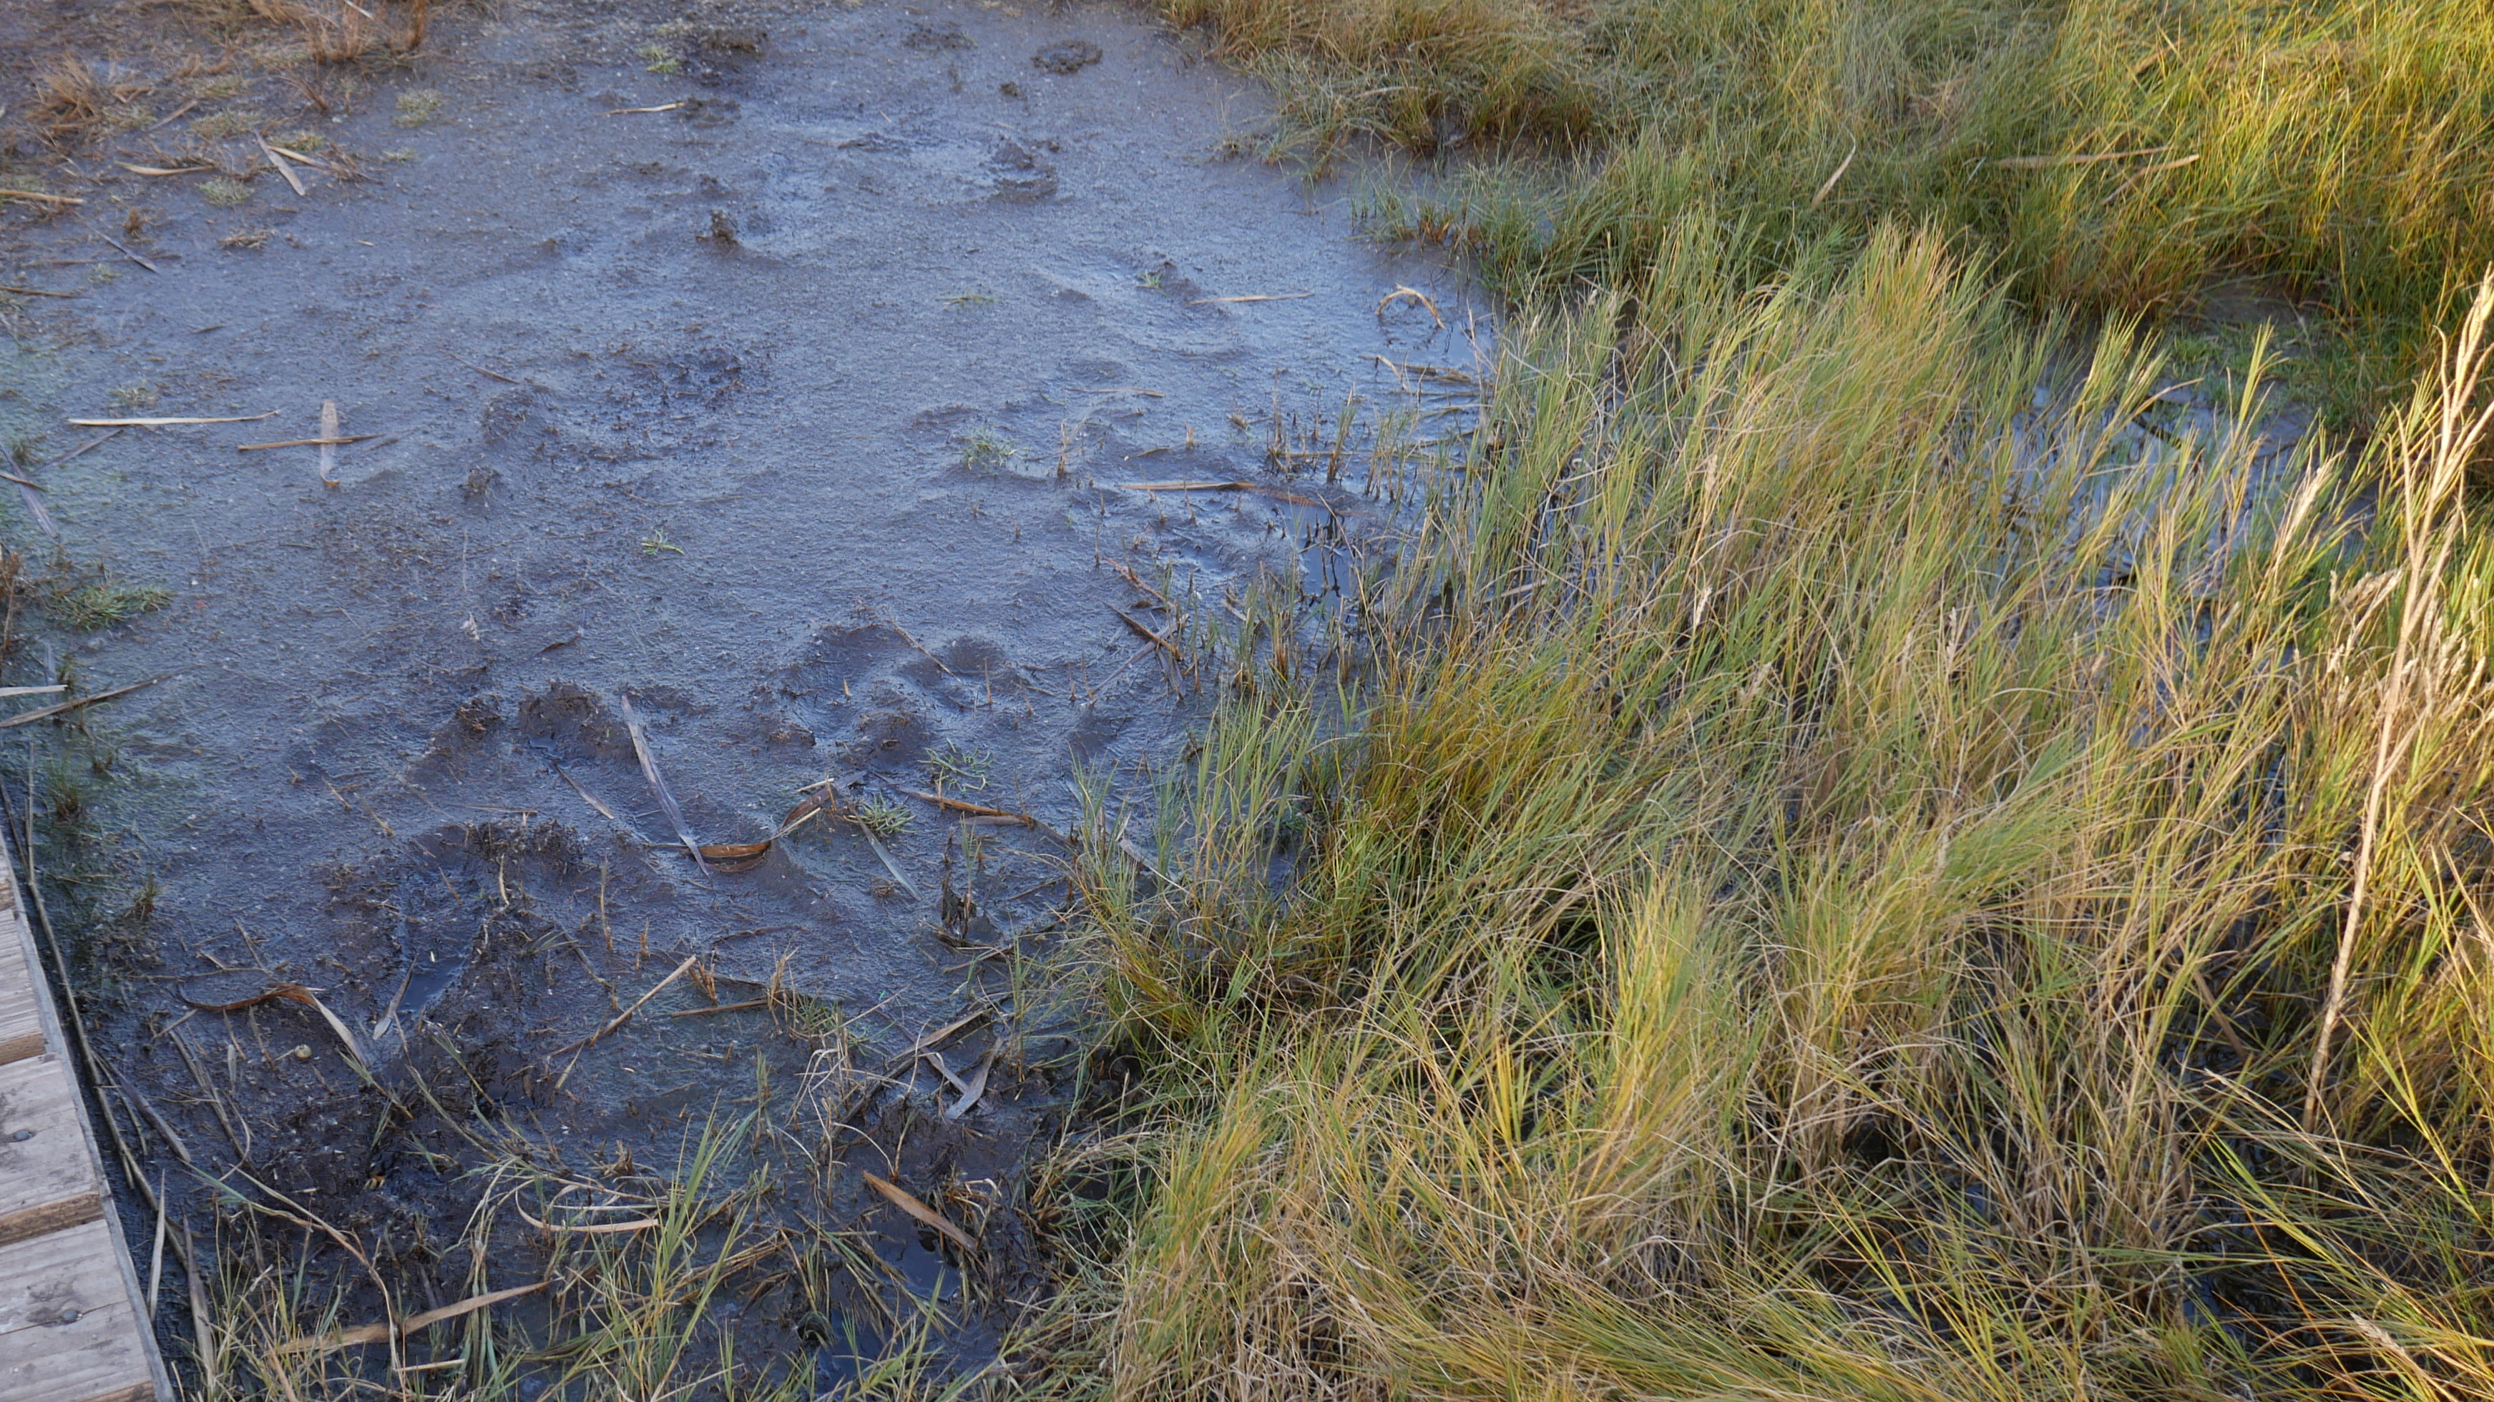
Winthrop Hydrologic Budget
 | Million Cubic Feet/Year
Total Inflow to Watershed | 490
Total Groundwater Recharge | 100
Total Surface Water Runoff | 145
ET from Watershed | 245
Soil Type | Acres | Percentage of Watershed (Doesn’t include Urban Lands)
A | 508 | 18%
B | 334 | 11%
C | 61 | 2%
D | 267 | 9%
Urban Lands | 538 | 19%
Unranked Lands* | 1139 | 40%
*Mostly Udorthents, wet substratum

Slide 5
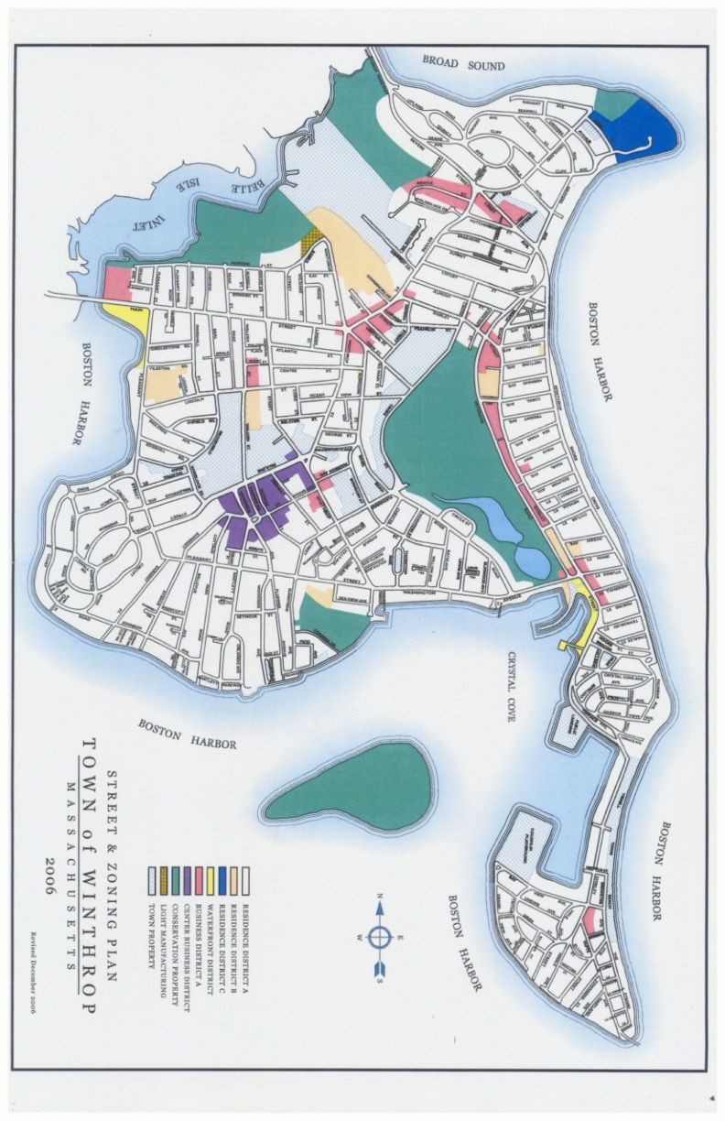
Street & Zoning Plan. (2006). Source: The Town of Winthrop Massachusetts.

Slide 6
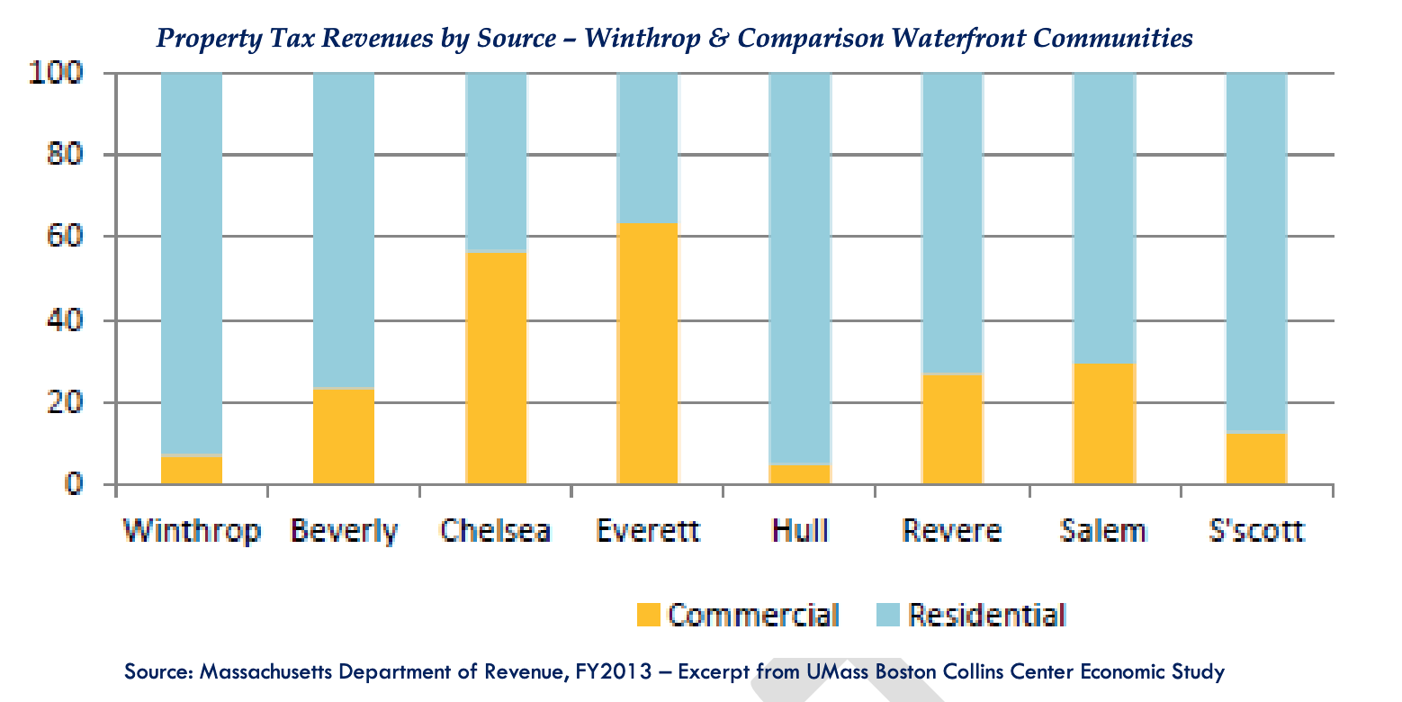
Retrieved from: https://www.town.winthrop.ma.us/sites/g/files/vyhlif4061/f/uploads/win2030_vision_draft_plan_report_jan2021.pdf

Slide 7
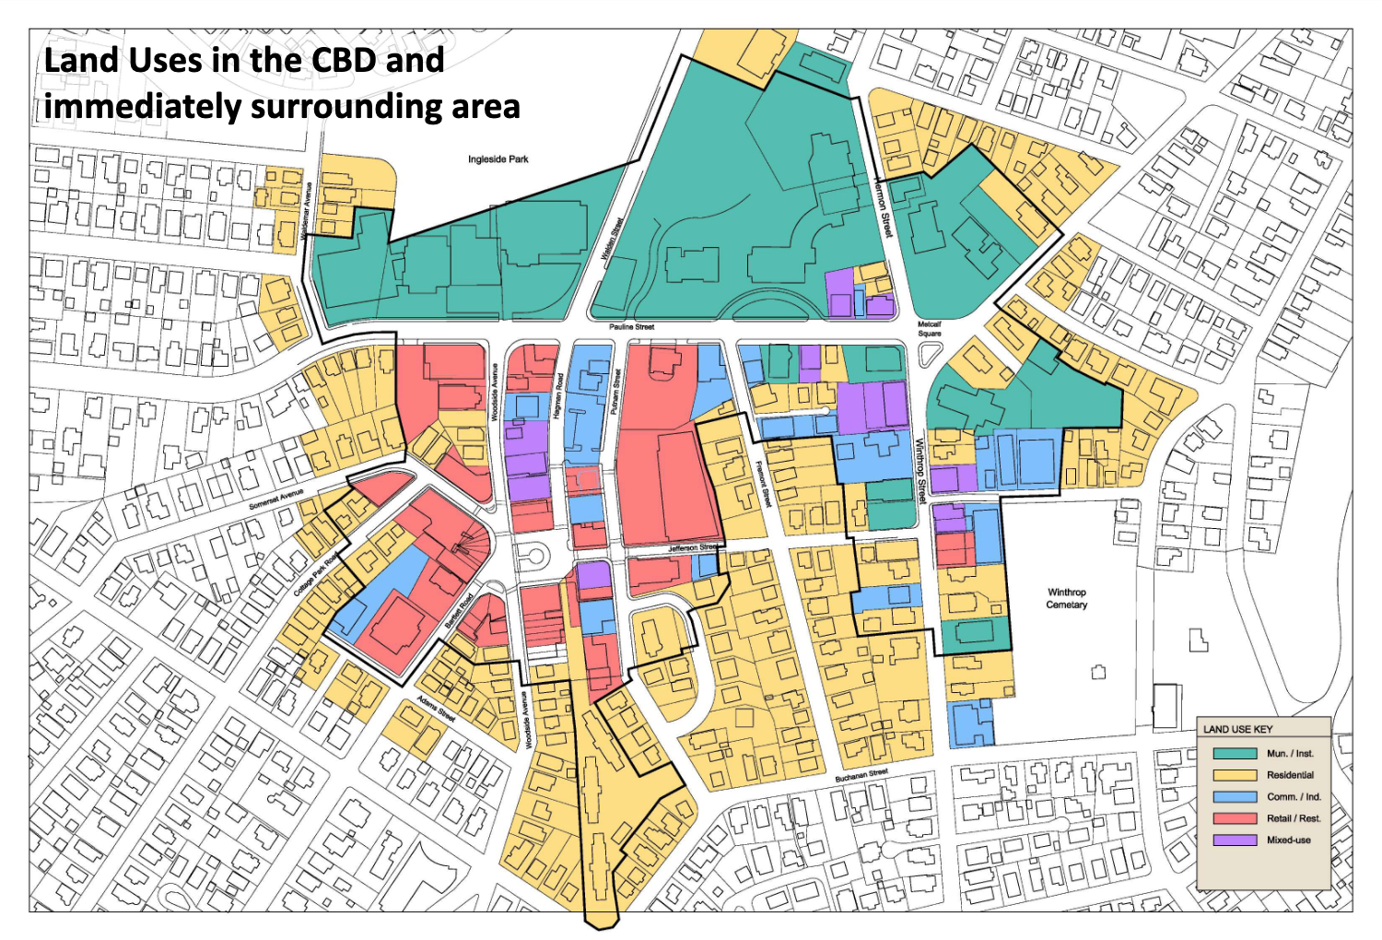
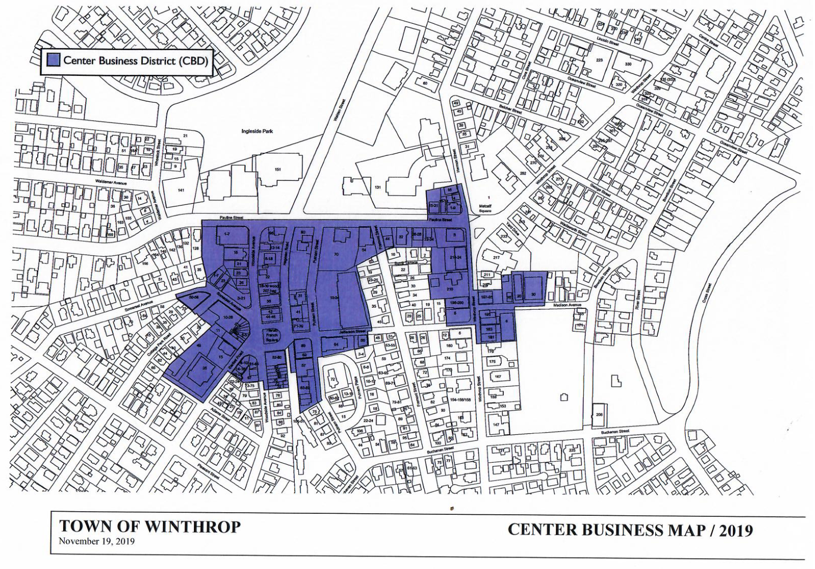
Winthrop Center Business Zoning Map Analysis (April 2019). Retrieved from: https://www.town.winthrop.ma.us/sites/g/files/vyhlif4061/f/uploads/cbd.final_.zoning_map.19_3.pdf
Town of Winthrop Center Business Map (November 2019). Retrieved from: https://www.town.winthrop.ma.us/sites/g/files/vyhlif4061/f/uploads/cbd.final_.zoning_map.19_3.pdf

Slide 8
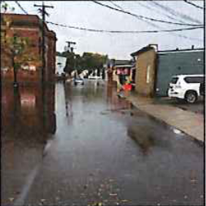
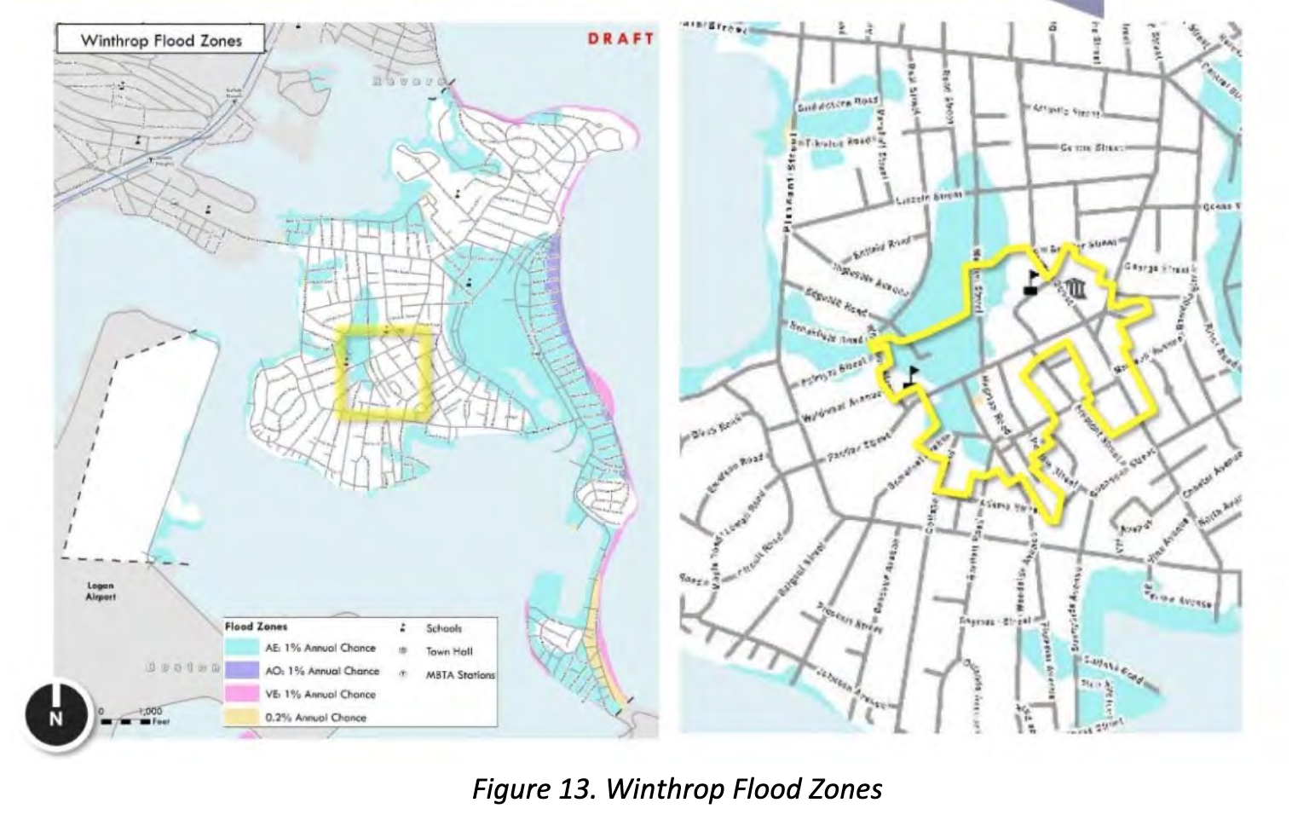
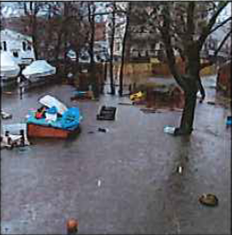
Town of Winthrop. (2017, March). Centre Business District Master Plan. Retrieved from https://www.massdevelopment.com/assets/what-we-offer/technical-assistance/centrebusiness-winthrop-032017.pdf

Slide 9
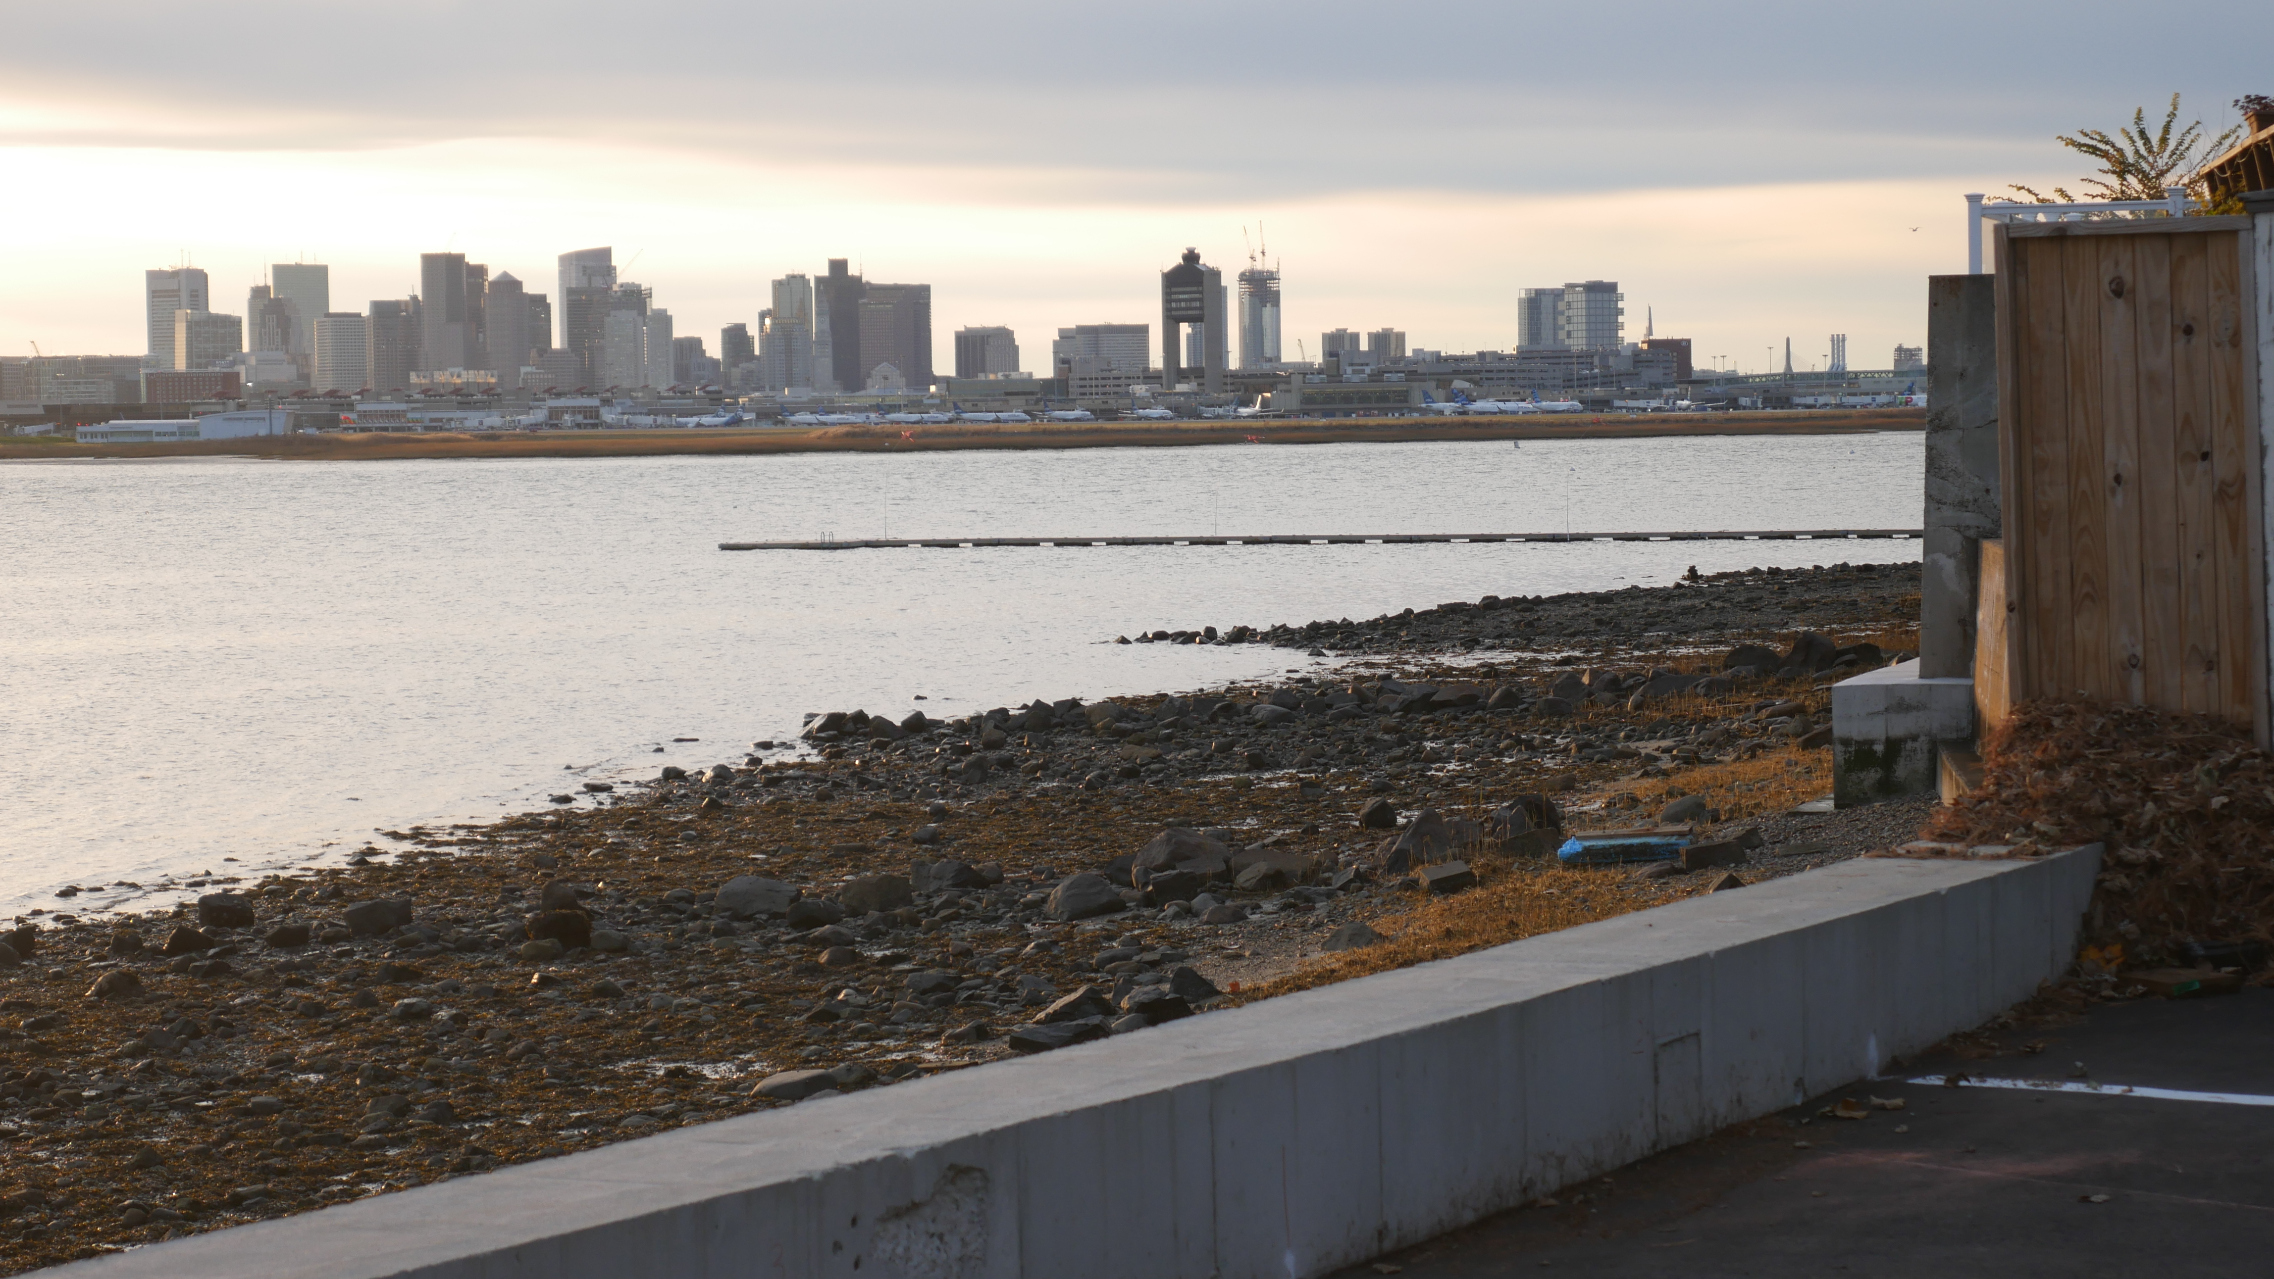
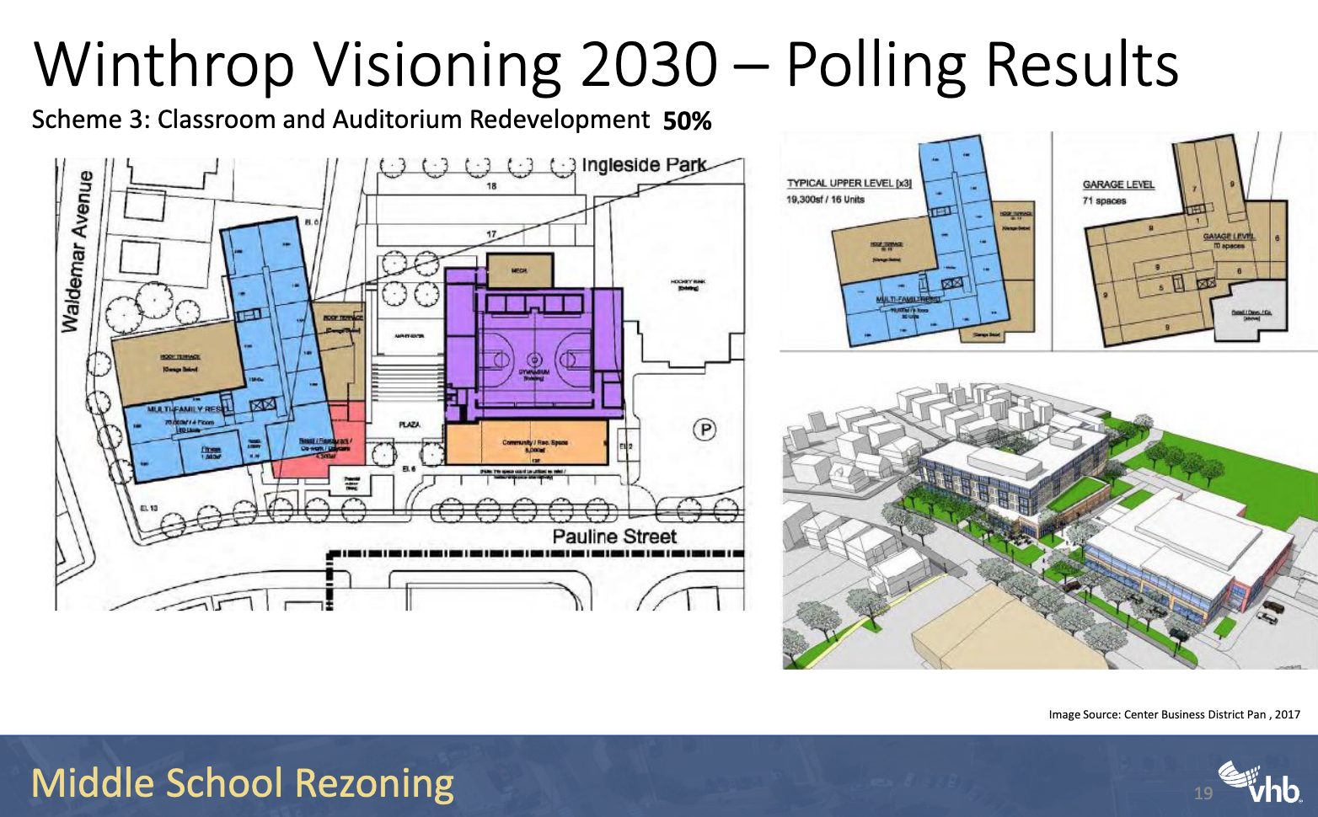
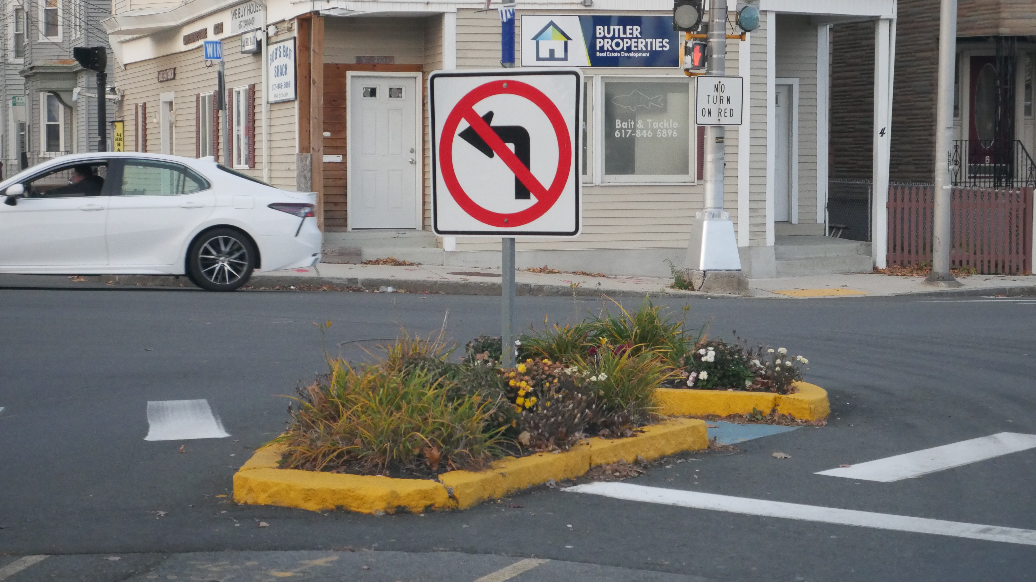
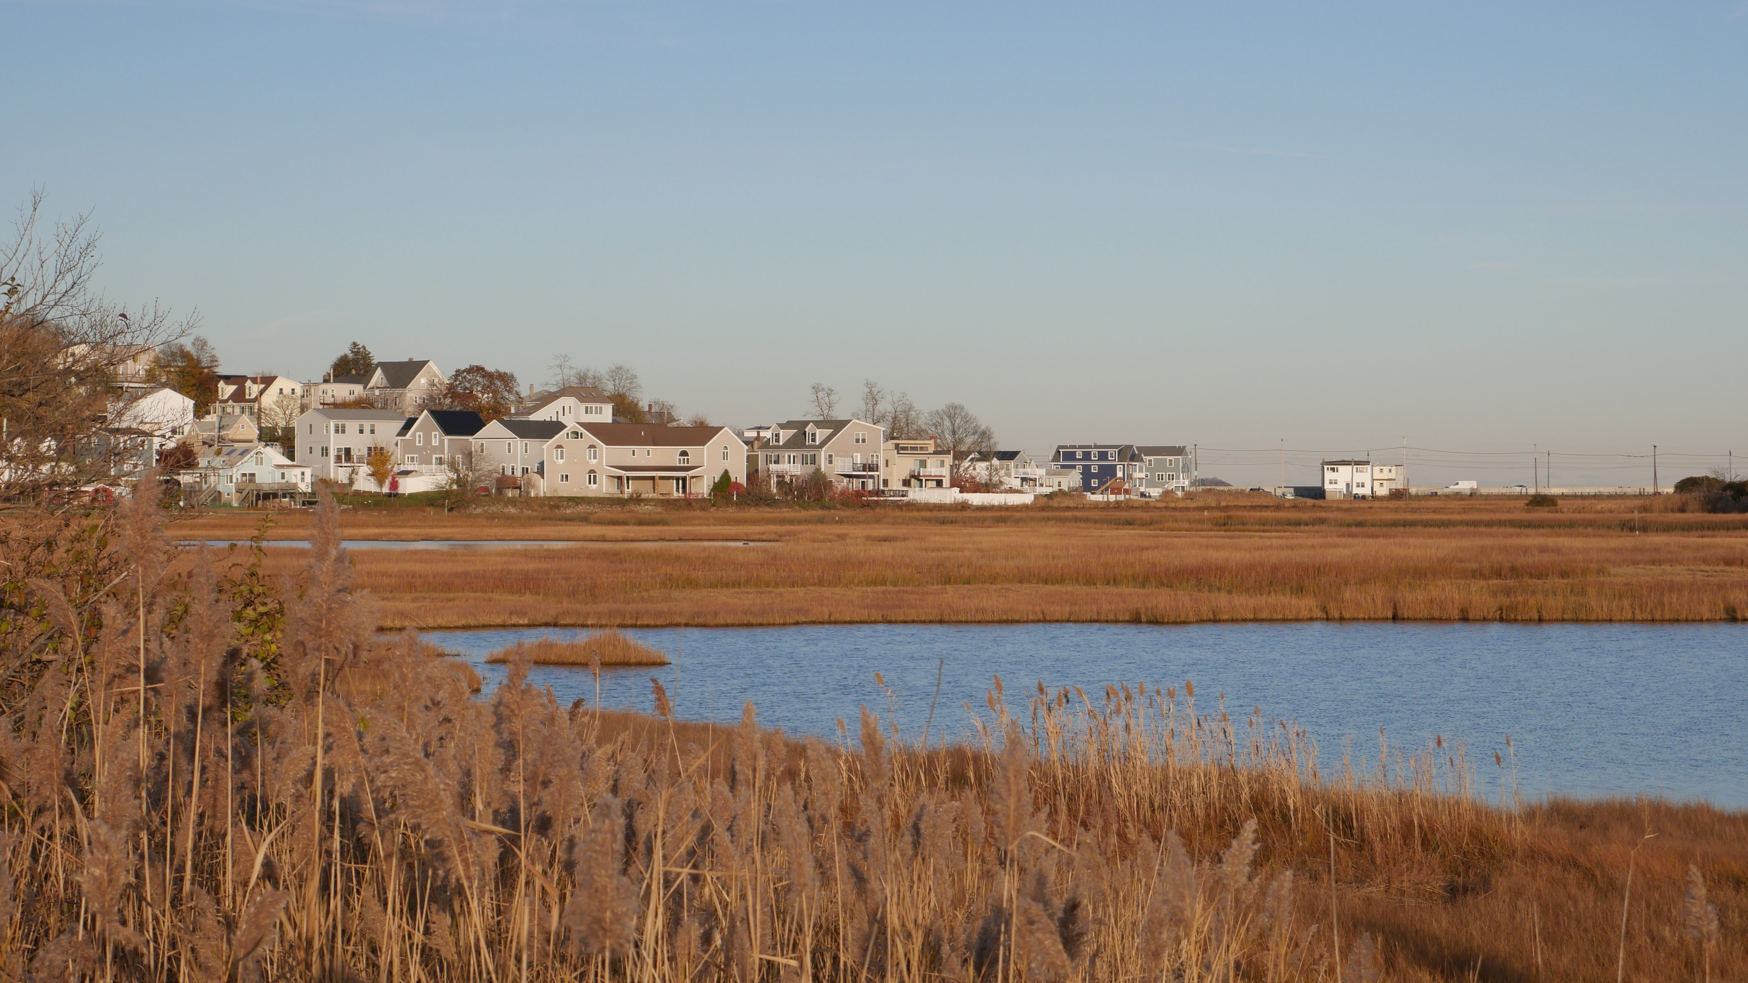
Recommendations
3
Shoreline Protection
2
Low Impact Development
Limitations for Implementation:
Lack of financial resources, even for infrastructure repairs
Winthrop is geographically isolated and lacks political and municipal accountability
4
Belle Isle Marsh Preservation – Encourage Transfer of development rights/ Conservation Easement
1
Public Education & Outreach
Other Recommendations:
Emergency evacuation plan
Improve public understanding of how to help with emergency preparedness (more workshops)
Increase community engagement and local political will

Slide 10
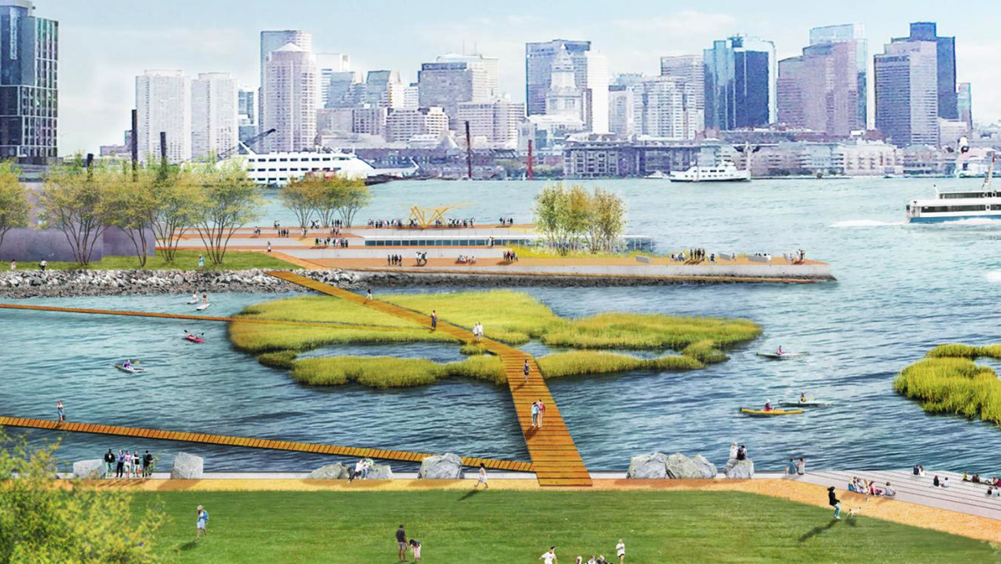
Thank You

